Slide 1
Learning with decision trees
Lee-Ad Gottlieb

Slide 2
Decision trees
A very popular approach is using decision trees for machine learning.
Before discussing the learning algorithms, we’ll survey the use of decision trees for information theory.

Slide 3
20 questions
I’m thinking of a person… can you guess who?
You can only ask binary (yes-no) questions
At most 20 questions…

Slide 4

20 questions
I’m thinking of a person… can you guess who?
You can only ask binary (yes-no) questions
At most 20 questions…

Slide 5
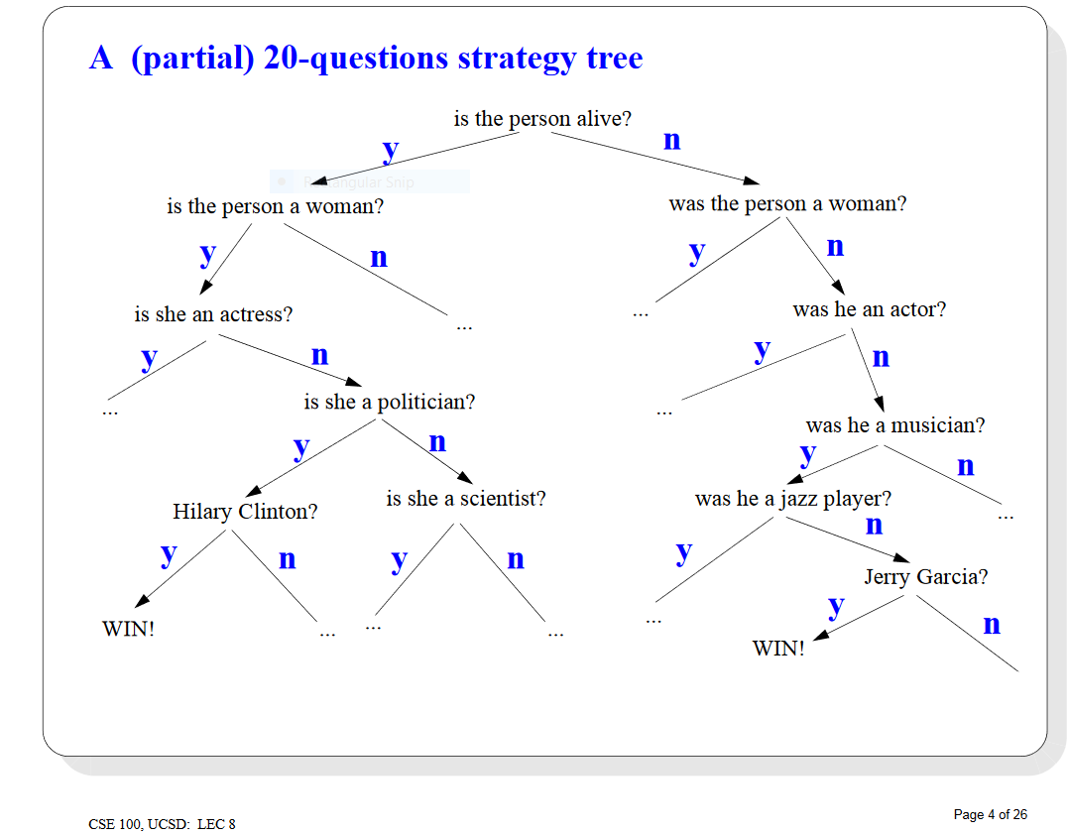

Slide 6
20 questions
A binary tree with 20 levels has
2²⁰ = 1,048,576 leaves.
That’s much larger than the number of people I know of.
So you should be able to win the game every time
At least if you have a good splitting strategy
For example, can use binary search dictionary (or encyclopedia) of people’s names

Slide 7
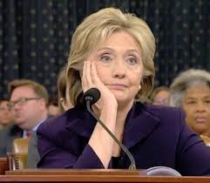
A different game
What if my goal is to ask the smallest number of questions on average?
Minimize expected number of guesses: Pr[x_{i}] * number_of_guesses[x_{i}]
For example
in our game above, suppose some people are much more likely to be chosen than others…
Up next!
Long detour into information theory.
Pr
> Pr

Slide 8
Information theory
Familiar compression schemes:
zip, 7z, rar, jpeg.
How compressed can a file get?
The field of information theory studies this.
Let an item be (for example) a letter in a long text…

Slide 9
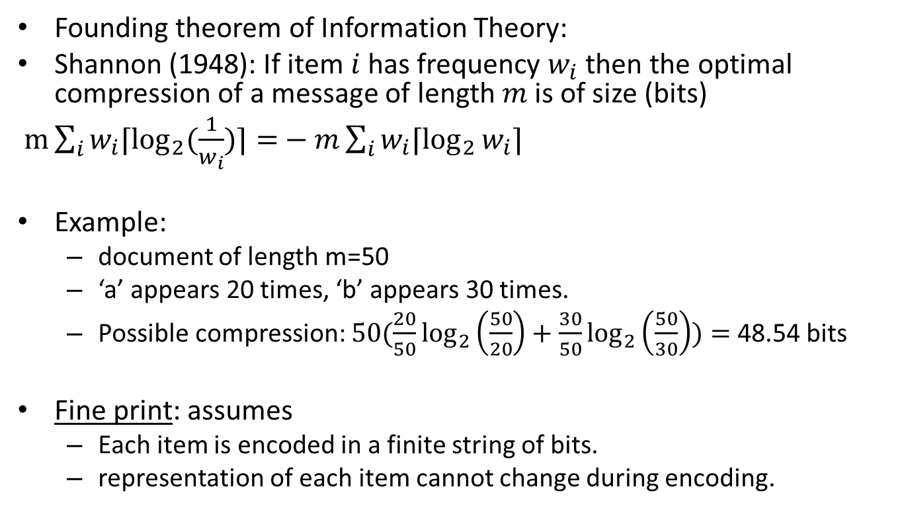
Information theory
Founding theorem of Information Theory:
Shannon (1948): If item $i$ has frequency $w_{i}$ then the optimal compression of a message of length $m$ is of size (bits)
$m\sum_{i}{w_{i}⌈\log_{2}{(\frac{1}{w_{i}})⌉=}}−m\sum_{i}{w_{i}⌈\log_{2}{w_{i}⌉}}$
Example:
document of length m=50
‘a’ appears 20 times, ‘b’ appears 30 times.
Possible compression: $50(\frac{20}{50}\log_{2}\left(\frac{50}{20}\right)+\frac{30}{50}\log_{2}\left(\frac{50}{30}\right))=$48.54 bits
Fine print: assumes
Each item is encoded in a finite string of bits.
representation of each item cannot change during encoding.
Entropy function

Slide 10
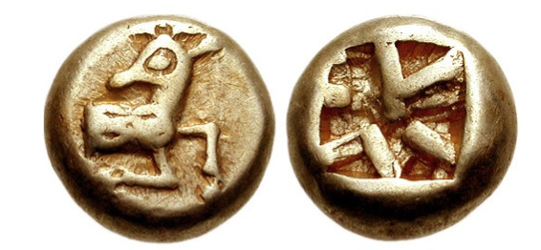
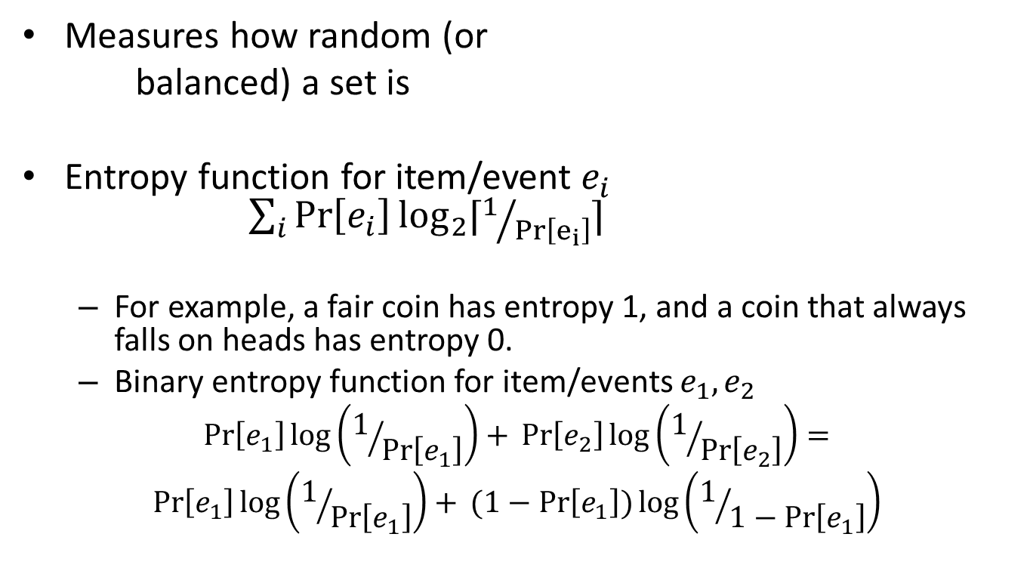
Entropy function
Measures how random (or
balanced) a set is
Entropy function for item/event $e_{i}$ $\sum_{i}{\operatorname{Pr}\left[e_{i}\right]\log_{2}{⁡⌈1/{\operatorname{Pr}\left[e_{i}\right]}⌉}}$
For example, a fair coin has entropy 1, and a coin that always falls on heads has entropy 0.
Binary entropy function for item/events $e_{1}, e_{2}$
$$\operatorname{Pr}\left[e_{1}\right]\log\left(1/{\operatorname{Pr}\left[e_{1}\right]}\right)+ \operatorname{Pr}\left[e_{2}\right]\log\left(1/{\operatorname{Pr}\left[e_{2}\right]}\right)=$$
$$\operatorname{Pr}\left[e_{1}\right]\log\left(1/{\operatorname{Pr}\left[e_{1}\right]}\right)+ (1−Pr\left[e_{1}\right])\log\left(1/{1−\operatorname{Pr}\left[e_{1}\right]}\right)$$

Slide 11
Information theory
Shannon’s theorem is non-constructive
He didn’t give a code that met his bounds
Huffman (1952): bottom-up construction realizes optimal bound
Give shorter codes to more frequently occurring items
First example: BAABAC = 010000010010
Second example: BAABAC = 1000100110
0
1
0
1
A
0
1
0
B
0
1
0
1
10
0
1
A
B
C
D
C
D
00
01
10
11
110
111

Slide 12
Information theory
Items: A,B,C,D,E,F,G,H
Message: AAAAABBAHHBCBGCCC
Could construct a balanced tree for coding
8 items
Each encoded into 3 bits
Message size: 3 * 17 = 51 bits
Can do better if we look at frequencies,
A:6, B:4, C:4, D:0, E:0, F:0, G:1, H:2

Slide 13
Huffman coding
Build tree bottom-up, combining lightest nodes (Frequencies A:6, B:4, C:4, D:0, E:0, F:0, G:1, H:2)
AAAAABBAHHBCBGCCC encodes to
0000000000010100111111011001110101010 – 37 bits
0
1
10
7
0
1
0
1
A
B
C
3
0
1
6
4
4
G
H
D
E
F
1
2
0
0
0

Slide 14
Learning with decision trees
We want to learn with decision trees.
Example: sample of binary vectors
Split rule: value in each dimension
0000 | +
0010 | +
0101 | -
0110 | +
1001 | -
1011 | -
1100 | +
1111 | -
First digit
0
1
Second digit
0
1
0
1
Third digit
+
-
Fourth digit
0
1
0
1
0
1
-
+
+
-
+
-

Slide 15
Learning with decision trees
What’s the VC-dimension of decision trees on binary d-dimensional vectors ?
T(k) – family of decision trees with k nodes
At each node, choose dimension to test, or mark it as a leaf in {+,-} – d+2 possible decisions
Size of T(k) ≤ (d+2)^{k} trees
VC-dim(T(k)) = O(k log d) (using Sauer’s lemma)

Slide 16
Learning with decision trees
So we want small k.
Problem: find decision tree which is consistent with the data and has the smallest number of nodes.
NP-hard.
Heuristics used instead.
ID3
Pruning

Slide 17
Random forest
ID3 algorithm. Top-down:
Start with root as a + leaf.
Function Cost measures quality of solution
Split leaf with rule that minimizes Cost
Repeat until consistent
+
0
1
0
1
+
-
-
0
1
+
-

Slide 18
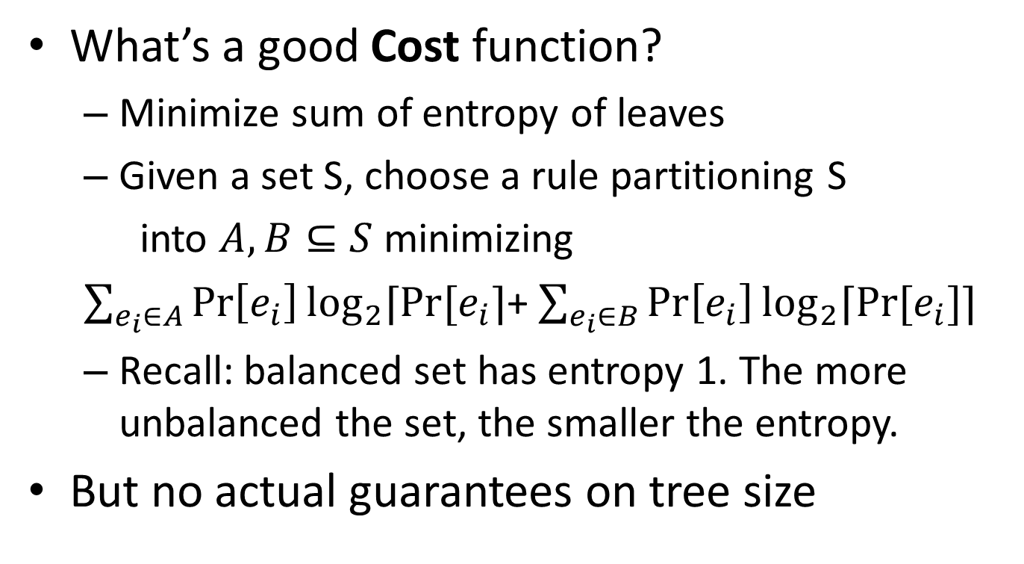
Random forest
What’s a good Cost function?
Minimize sum of entropy of leaves
Given a set S, choose a rule partitioning S
into $A,B⊆S$ minimizing
$\sum_{e_{i}∈A}{\operatorname{Pr}\left[e_{i}\right]\log_{2}{⁡⌈Pr⁡[e_{i}⌉}}$+ $\sum_{e_{i}∈B}{\operatorname{Pr}\left[e_{i}\right]\log_{2}{⁡⌈Pr⁡[e_{i}]⌉}}$
Recall: balanced set has entropy 1. The more unbalanced the set, the smaller the entropy.
But no actual guarantees on tree size
+
0
1
+
-

Slide 19
Pruning
Another way to achieve small tree - inconsistent
Can do it after brute-force or ID3
Remove nodes starting at the bottom. Options:
Do nothing
Make internal node into leaf in {0,1}
Replace with subtree
First digit
0
1
Second digit
0
1
0
1
Third digit
+
-
0
1
0
1
-
+
+
-

Slide 20
Pruning
Another way to achieve small tree - inconsistent
Can do it after brute-force or ID3
Remove nodes starting at the bottom. Options:
Do nothing
Make internal node into leaf in {0,1}
Replace with subtree
First digit
0
1
Second digit
-
0
1
Third digit
+
0
1
-
+

Slide 21
Pruning
Another way to achieve small tree - inconsistent
Can do it after brute-force or ID3
Remove nodes starting at the bottom. Options:
Do nothing
Make internal node into leaf in {0,1}
Replace with subtree
First digit
0
1
Second digit
-
Third digit
0
1
-
+

Slide 22
Random forest
State-of-the-art
Compute many random decision trees
ID3 with pruning, for example
Take majority decision
0
1
0
1
+
0
1
0
1
+
-
0
1
0
1
0
1
0
1
-
+
+
-
-
+
+
-

